Slide 1
Proposed ESL Pathways
Curriculum Committee Meeting February 4, 2026

Slide 2

Why?
Response to AB 1705
Shortens ESL Pathway
Integrates Reading & Writing Courses
Reduces 10 units / 14 hours
Creates Flexible Pathways

Slide 3

CORE courses
Provide pathway to English C1000 within 3 years
Fill GAP in current ESL sequence
Shorten time to complete core courses
Implement Best Practices in our field
(integrate reading & writing)
Provide opportunity to earn UC transferable course (Humanities)

Slide 4
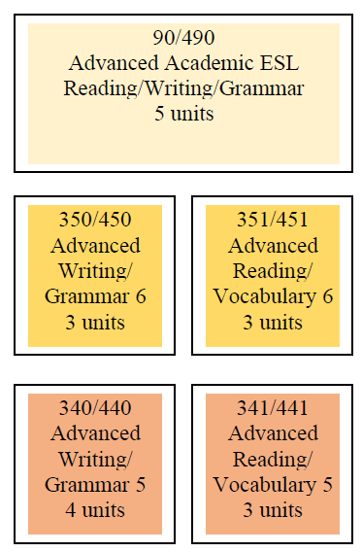
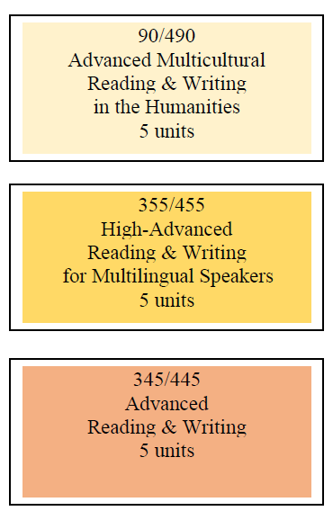
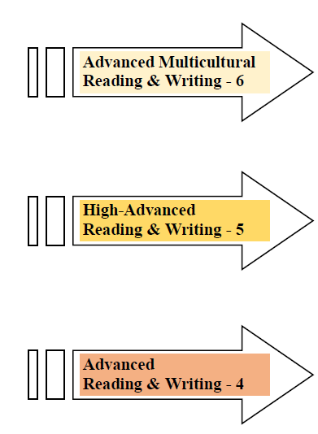
Advanced Level ESL
CURRENT
PROPOSED

Slide 5
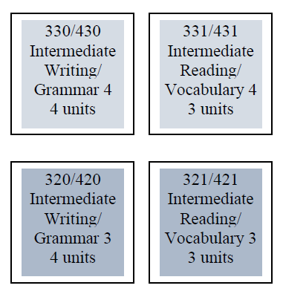
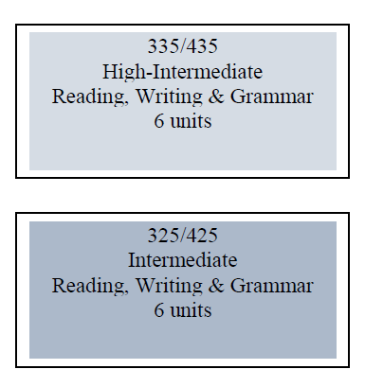
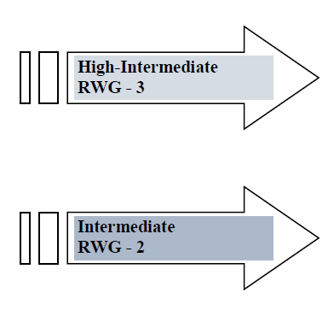
Intermediate Level ESL
CURRENT
PROPOSED

Slide 6
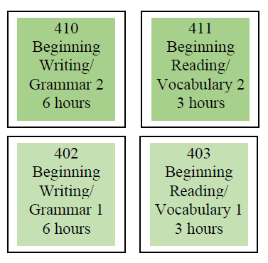
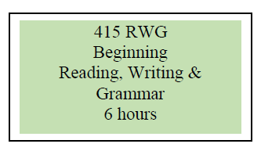
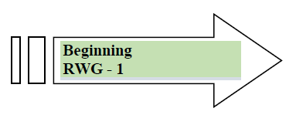
Beginning Level ESL
CURRENT
PROPOSED

Slide 7


Additional Language Skills Needed for Success
Diverse Multilingual Student Population
Various Language Acquisition Needs

Slide 8


Career Development & College Preparation (CDCP)
ESL Certificates
Flexible for Multilingual Speakers:
Allow students to meet various language needs
Group certificates by levels & skills
Reduce number of courses needed for each certificate
Provide courses needed for success

Slide 9

AB 540
210 hours / semester
420 hours / year
CA residency status
Affordable Pathway:
  CTE Certificate
  AA/AS degree

Slide 10
New CDCP ESL Certificates
6 Certificates (levels)
4 Certificates (skills)
Combine one Reading & Writing course
One elective
  Listening & Speaking
  Grammar
  Digital Literacy (computer skills)
Listening & Speaking
Grammar
Digital Literacy (computer skills)

Slide 11

28
Thank you!

